Slide 1
Fostering labour market integration of persons with disabilities by partnerships
Results of current research activities
Anette Scoppetta, Deputy Director and Head of Work and Welfare Programme

Slide 2
Key questions of the day
What partnerships can be harnessed to facilitate labour market integration of people with disabilities?
How could the role of social partners be enhanced in labour market integration of people with disabilities and people returning to work after or with chronic diseases?
What examples of cooperation between different levels of implementation and practice, knowledge sharing and policy making, ranging from local, enterprise, sectoral, national, or EU levels can serve as inspiration across different EU contexts?
My answers to the key questions derive mainly from the following research & applied science projects:
CoP Employment, Education and Skills (former Employment Thematic Network) of the ESF Transnational Cooperation Platform (2017-today)
Peer review “Employer Service Delivery” (26-28 October 2020, virtual; hosted by The Netherlands)
Social Situation Analysis in Austria with focus on impact of governmental measures on persons with disabilities as response to the COVID-19 pandemic (6/2020-8/2020)
Austrian TEPs (past Austrian partnerships 2000-2014)
2

Slide 3
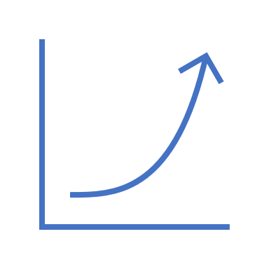
Situation in Austria as example
18,4% of the Austrian resident population live with a disability (2015)
Increase of registered PwD and persons with health-related placement handicaps and increase of unemployment rate of PwD (2018: 8.0%; general unemployment rate 2018: 4.9%)
The share of registered unemployed with health-related employment limitations of all registered unemployed was 24% in 2018
PwD did not benefit from the recovering of the 2009 crisis of the labour market (women are still more heavily affected by the situation than men)
PwD are heavily effected by COVID-19 (only emergency operation of services; it took its time to set specific measures for them e.g. exemption of the rule for wearing protective masks)
→ Pandemic as amplifier of existing problems and as trigger of new problems
3
Notes:
Approx. EUR 530 million were spent in total in 2018 as part of the ALMP offered by the PES and as part of the Ministry for the social participation and professional integration of PwD
Disability Employment Act: obligation to employ PwD; for each quota-place that is not filled a compensatory levy (at least EUR 257 per month) must be paid

Slide 4
Institutional challences faced
Shared public responsibility in many EU-MS on PwD
In AT: the Ministry, the PES at various governance levels - here two PES departments offer services: the Job Seekers department supports the counselling of PwD, the Enterprise department consults enterprises concerning hiring PwD - and the federal provinces
But a well-functioning cooperation between institutions, i.e. interplay between all relevant actors at the same eye level including service providers such as NGOs and social partners is very often missing
Ongoing communication, coordination and interface management at central level as well as at regional/local levels is needed
→ Multi-level governance arrangements between public, private and civil society organisations
4

Slide 5
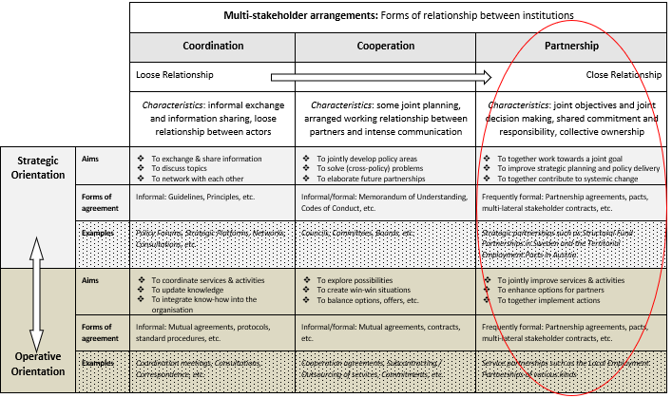
Source: Adapted and simplified from Scoppetta, 2013
5

Slide 6
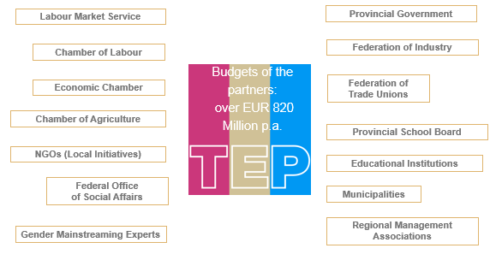
Example: Austrian TEPs (1996-2014)
Rationale: Labour market challenges exist, which can not be met by just a few institutions on their own e.g. concentration of unemployment on certain groups of persons, shifts between industries, economic sectors and regions.
TEPs are contracted regional partnerships to better link employment policy with other policies to improve the employment situation on regional and local level.
6

Slide 7
Institutional frame & freedom of choice
No single institution can address the various needs of PwD alone: there is a strong need for collaborative approaches taken for locally embedded services
Policy interventions should reflect the macro-, meso- and micro level:
Macro: systemic links between policies (e.g. active labour market policy and social assistance)
Meso: the organisational level, at which stakeholders experience (institutionalised) ways of collaborative work
Micro: the beneficiary level at which users receive support via services and measures
While participation is voluntarily, services must be offered on a broad scale to serve the varying needs
Macro -
Meso -
Micro-level
7

Slide 8
Integration of PwD & local know-how in policy design & implementation
The needs of PwD are multi-facetted and to be placed at the heart of any policy intervention
Offers must reflect/be flexible & tailored to the various needs of individuals including their family situation – There is no one-size-fits-all approach applicable
Solutions should creating win-win situations for all involved: enterprises, PwD and the society as a whole
Job carving & Job Crafting to be applied as a successful approach practiced in Malta, Belgium, etc.
8

Slide 9
Job Carving & Job Crafting
Adapt tasks, processes, physical workplaces and/or the meaning of work in line with individuals’ talents, needs and interests.
Job carving refers to the practice of rearranging work tasks within a company to create tailor-made employment opportunities
Innovative approach to adapt workplaces and/or to create new ones in line with peoples’ individual talents, needs and motivations
Job carving: Top-down, management driven
Job crafting: Bottom-up, driven by individuals
Scoppetta, Davern & Geyer (2019)
9

Slide 10
Example Malta
 | Job-carving for jobseekers with disabilities
Country | Malta
Rationale | Enforcement of the 2% employment quota for PwD and the gap between the “requirements” of existing vacancies and the “preparedness” of the disabled jobseeker, job-carving was adopted.
Aims | Increase the labour market integration of jobseekers with disabilities; and Change the perspective of employers on the employment of people with disabilities.
Impact | As of April 2018, it was possible to create 278 jobs suitable to the jobseekers with disabilities by making use of the job-carving approach.
10
Scoppetta, Davern & Geyer (2019)

Slide 11
Policy & practice
Policy and practice solutions should:
Target at inclusion into society (not primarily economic/labour market inclusion)
Include long-term perspectives (over various phases of life, intergenerational, taking into account the life-course perspective)
Follow a preventive approach (from indicated to universal)
Include the family perspective of the PwD
Look at the quality and sustainability of jobs created and filled by PwD
Be embedded in cooperative settings …
11

Slide 12
Conclusions
What partnerships?
Well-functioning multi-level governance arrangements between public, private and civil society institutions are rarely found but are a key for success in the integration of PwD into the labour market
Role of social partners?
Partnerships between actors and especially with social partners are core within the Structural funds, such as the ESF/European Social Fund and thus need to be used for the benefit of PwD.
Policy measures such as Job Carving & Job Crafting and partnership programmes such as the TEPs in Austria should be developed together with all relevant actors, such as the individuals and their family, the enterprise, the social partners, the public donor, NGOs, etc.
Examples of cooperation?
Job Carving and Crafting in Malta, Belgium, etc as well as Austrian TEPs, but also Belgium and Irish partnership approaches
12

Slide 13
References
BMSGPK (2020). Covid-19 Social Situation Analysis in Austria. Chapter “People with Disabilities” written by Anette Scoppetta. Vienna: BMSGPK, p. 234-257.
Scoppetta, A. (2020). PES Services for employers: Focussing on competences of persons with disabilities is key for success. Peer Country Comments Paper - Austria for the Peer review on “Employer service delivery”. Mutual Learning Programme (on behalf of the EC/DG Empl; In collaboration with ICF).
Scoppetta, A., Davern, E. & Geyer, L. (2019), Job carving and job crafting. European Commission. ESF Transnational Platform. Brussels: European Commission, DG Employment, Social Affairs and Inclusion.
Scoppetta, A. Successful partnerships in delivering public employment services - Analytical Paper for DG Employment, Social Affairs and Inclusion, PES to PES Dialogue, The European Commission Mutual Learning Programme for Public Employment Services: Brussels, Belgium, 2013.
13

Slide 14
Thank you very much for your attention!
scoppetta@euro.centre.org

