Slide 1

Labour market integration of persons with disabilities and chronic diseases
Netherlands – Collective agreement stipulations of the University Medical Centres
Adam Šumichrast
Central European Labour Studies Institute
November 20, 2020

Slide 2
Trade unions in NE
TUs in Netherlands are characterized by a stable formal position, but also with a crumbling power base
TUs still play a crucial role in determining the employment conditions for every three out of four employees, through collective bargaining with the employers
collective bargaining takes place both at the company level and at the industry level

Slide 3
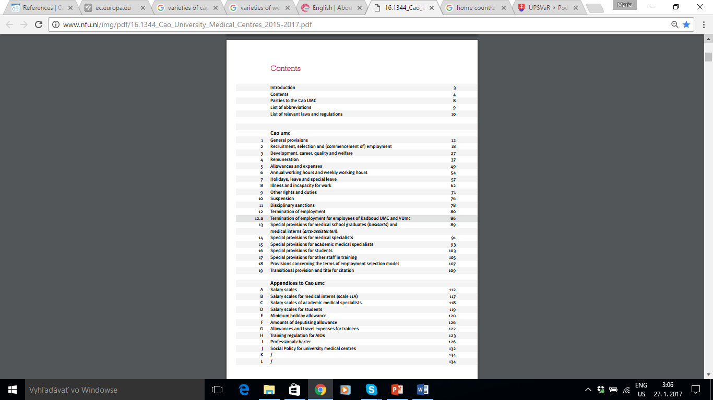

Example: CA for university medical centres in NL

Slide 4
Article 8.2 Occupational health care
1 The employer shall provide occupational health care counselling for employees.
Article 8.3 Reintegration
1 The employer shall develop activities as soon as possible for employees who are prevented from performing their work through incapacity by reason of illness or disability aimed at the reintegration of the employee and culminating in the adoption of a reintegration plan. These activities shall include a review of whether there is a relationship between the incapacity due to illness or disability and the working conditions.
2 The employer may lay down further rules for the application of the first paragraph.
Article 8.5 Continued payment of salary
1 Employees who are wholly or partially prevented from performing their work through incapacity
due to illness or disability shall continue to receive their salary for a period of 52 weeks. After
52 weeks, the employee shall retain 70% of his salary over the hours of the sick leave

Slide 5
Article 8.5.1. Reassignment due to incapacity to work
The employer may assign an employee who is unfit to perform his work due to illness or disability to another job or instruct him to carry out his own job under different conditions.
The employee is obliged to accept a job offered to him on the basis of the first paragraph if it constitutes suitable work.
Article 8.5.7. Obligations of the employer
The employer is obliged as soon as possible to take such measures and issue such instructions as are reasonably necessary to allow the employee or the former employee who is prevented from performing the agreed work in connection with incapacity due to illness to perform his own work or other suitable work (…)

Slide 6

THANK YOU!
adam.sumichrast@celsi.sk

